Slide 1
Gen AHB User Manual

Slide 2
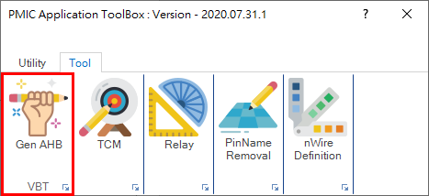
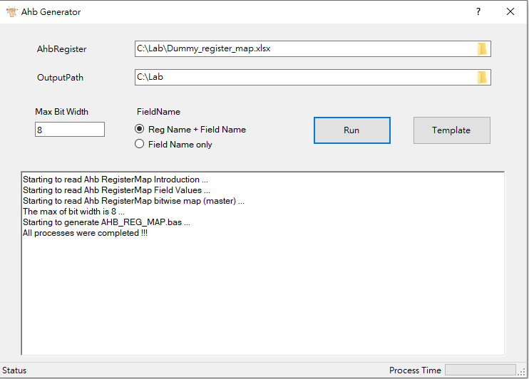
Gen AHB
Purpose
To generate AHB Enum .bas files from AHB Register map
GUI
Select Source register map file

Slide 3
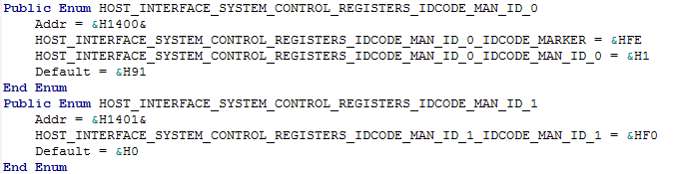
Gen AHB
AHB_register_map Format
reg address : Address of register.
reg name : Register Name
field name : Field Name
field width/field offset : The max Bit width is field width + field offset
hw reset value : It’s default value when hw reset.
Output
register name
Bitwise complement
field name-1
00000001 (Bin) => 11111110 (Bin) => FFFFFFE(Hex)
field name-2
11111110 (Bin) => 00000001 (Bin) => 0000001(Hex)
The purpose of Bitwise complement is to protect unwritten address

Slide 4
Gen AHB
Others
If the count of Enum is more than 1000, then separate to individual Bas File.
The default max Bit Width is 8 ,and user can change it anytime.
Field Name optional :
Field name only
Reg name + Field name
Public Enum HOST_INTERFACE_System_Control_Registers_IDCODE_MAN_ID_0
Addr = &H1400&
IDCODE_MARKER = &HFE
IDCODE_MAN_ID_0 = &H01
Default = &H91
End Enum
Public Enum HOST_INTERFACE_System_Control_Registers_IDCODE_MAN_ID_0
Addr = &H1400&
HOST_INTERFACE_System_Control_Registers_IDCODE_MAN_ID_0_IDCODE_MARKER = &HFE
HOST_INTERFACE_System_Control_Registers_IDCODE_MAN_ID_0_IDCODE_MAN_ID_0 = &H01
Default = &H91
End Enum

Slide 5
Appendix

Slide 6
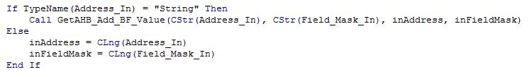
Syntax change
Below is Enum method for AHB write/read
Enum(Long)
AHB_WRITE WLED_DIG_TEST_CFG_3.Addr, g_RegVal,WLED_IDAC_MAIN_CFG_3_CFG_IDAC_BIT6_BIN_TRIM
In order to release more memory for other modules, remove AHB Enum and use “String” type of Address/Filed name
(String)
AHB_WRITE "WLED_IDAC_MAIN_CFG_3.CFG_IDAC_BIT6_BIN_TRIM“, g_RegVal
Use “.” to separate Reg name and Filed name
Both two type(Enum or String) is acceptable for original function

